Slide 1



Home
About
Hotels
Rooms
Contact
Hamro Booking Sewa
Start searching for your hotel room
Laxman Parajuli
Sandhya Banstola
Ujjwal Adhikari

Slide 2

Hamro Booking Sewa
Home
About
Hotels
Rooms
Contact
Introduction
Hamro Booking Sewa is a laravel and react native based android application project on online hotel booking where users can view, select and book hotel.
The project has different modules in the development work, which are divided among super admin, hotel owners, customers, and search option

Slide 3

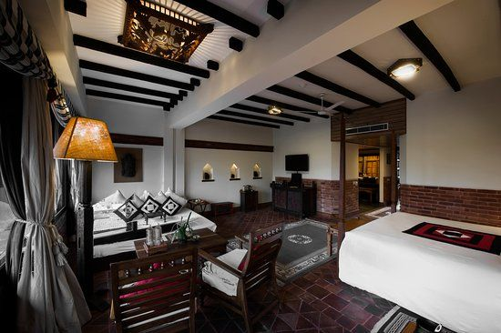
Hamro Booking Sewa
Home
About
Hotels
Rooms
Contact
Completed
Fetch data from laravel in mobile app in JSon format
Sections for hotel and hotel rooms created in backend

Slide 4
Hotel Booking Sewa
Home
About
Hotels
Rooms
Contact
Needs To Be Done
01.
02.
03.
Pricing Transparency
Information Inconsistency
Customer Assistance
Online hotel booking apps lacks of transparency in pricing.
Online hotel booking apps are often inconsistent in the quality of information provided.
Online hotel booking apps may lack customer support and assistance.

Slide 5

Hamro Booking Sewa
Home
About
Hotels
Rooms
Contact
Bottlenecks
01.
API integration
Fetching pictures in JSon format
02.
03.
Manipulation of multiple pictures

Slide 6


Hamro Booking Sewa
Home
About
Hotels
Rooms
Contact
Other Issues
1.
2.
3.

Slide 7

Hamro Booking Sewa
Home
About
Hotels
Rooms
Contact
Navigation
Home
About
Hotels
Rooms
Contact
Thank You

